Slide 1
Node Embeddings

Slide 2
Given an input graph, extract node, link and graph-level features, learn a model (SVM, neural network, etc.) that maps features to labels.
Input Graph
Structured Features
Learning Algorithm
Prediction
Feature engineering
(node-level, edge-level, graph- level features)
Downstream prediction task

Slide 3
Graph Representation Learning alleviates the need to do feature engineering every single time.
Input Graph
Structured Features
Learning Algorithm
Prediction
Feature Engineering
Representation Learning --
Automatically learn the features
Downstream prediction task

Slide 4
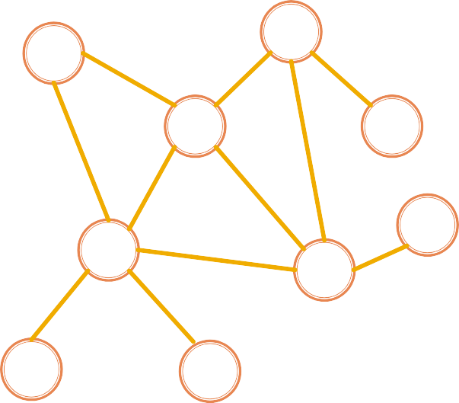
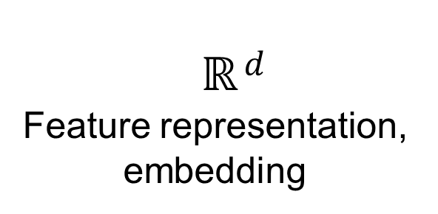
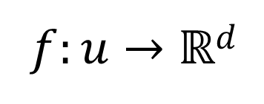
Goal: Efficient task-independent feature learning for machine learning with graphs!
node
𝑢
vector
𝑓: 𝑢 → ℝ$d$
_{ℝ}$d$
Feature representation, embedding
4

Slide 5

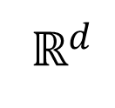
Task: map nodes into an embedding space
Similarity of embeddings between nodes indicates their similarity in the network. For example:
Both nodes are close to each other (connected by an edge)
Encode network information
Potentially used for many downstream predictions
Vec
Tasks
Node classification
Link prediction
Graph classification
Anomalous node detection
Clustering
….
embeddings
ℝ$d$

Slide 6
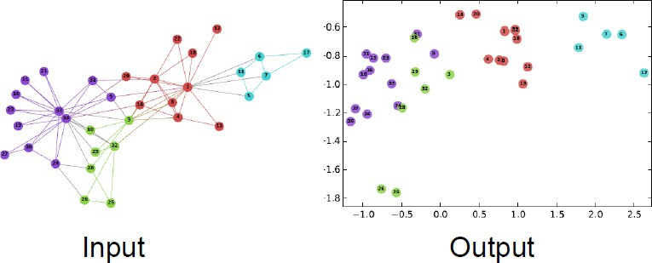
2D embedding of nodes of the Zachary’s Karate Club network:
Image from: Perozzi et al. DeepWalk: Online Learning of Social Representations. KDD 2014.

Slide 7
Node Embeddings:
Encoder and Decoder

Slide 8


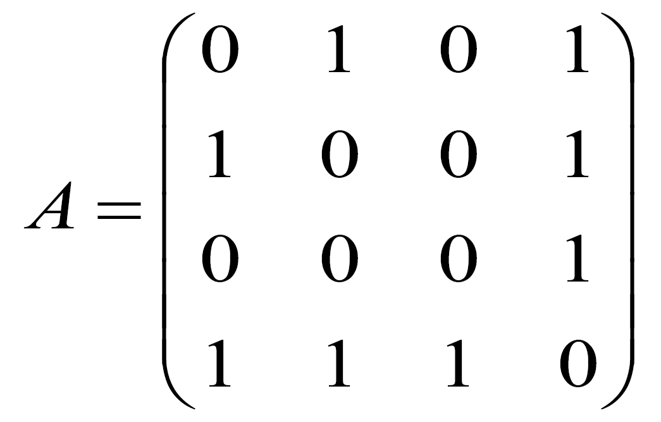



Assume we have a graph G:
V is the vertex set.
A is the adjacency matrix (assume binary).
For simplicity: no node features or extra information is used
4
3
2
1
V: {1, 2, 3, 4}

Slide 9

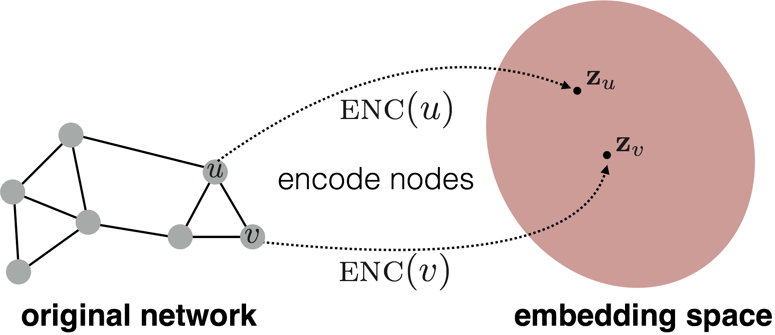
Goal is to encode nodes so that similarity in the embedding space (e.g., dot product) approximates similarity in the graph

Slide 10

Goal:
similarity 𝑢, 𝑣
in the original network
Similarity of the embedding
Need to define!

Slide 11
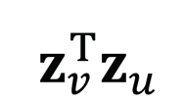
1. Encoder maps from nodes to embeddings
Define a node similarity function (i.e., a measure of similarity in the original network)
Decoder 𝐃𝐄𝐂 maps from embeddings to the similarity score
Optimize the parameters of the encoder so
that:
similarity 𝑢, 𝑣
in the original network
𝐃𝐄𝐂($z_{v}$ , $z_{u}$) $=$
Similarity of the embedding

Slide 12
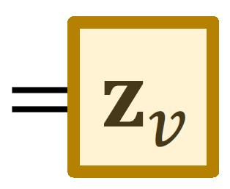
Encoder: maps each node to a low-dimensional
vector
d-dimensional embedding
ENC 𝑣
node in the input graph
Similarity function: specifies how the relationships in vector space map to the relationships in the original network
similarity 𝑢, 𝑣
Similarity of 𝑢 and 𝑣 in the original network
Decoder
dot product between node embeddings

Slide 13

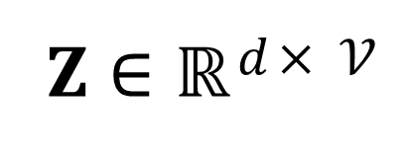
Simplest encoding approach: Encoder is just an embedding-lookup
ENC 𝑣 = 𝐳_{𝒗} = 𝐙 ⋅ 𝑣
_{𝚭 ∈ ℝ}$d$× 𝒱
matrix, each column is a node embedding [what we learn /optimize]
indicator vector, all zeroes except a one in column indicating node v
𝑣 ∈ 𝕀 ^{𝒱}
13

Slide 14


Simplest encoding approach: encoder is just an embedding-lookup
embedding vector for a
embedding matrix
specific node
𝐙 =
Dimension/size of embeddings
one column per node

Slide 15
Simplest encoding approach: Encoder is just an embedding-lookup
Each node is assigned a unique embedding vector
(i.e., we directly optimize the embedding of each node)
Many methods: DeepWalk, node2vec
15

Slide 16

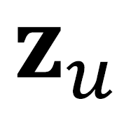
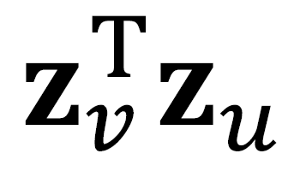
Encoder + Decoder Framework
Shallow encoder: embedding lookup
Parameters to optimize: 𝐙 which contains node embeddings for all nodes 𝑢 ∈ 𝑉
We will cover deep encoders (GNNs) in the future
Decoder: based on node similarity.
Objective: maximize for node pairs (𝑢, 𝑣)
that are similar
16

Slide 17
Key choice of methods is how they define node similarity.
Should two nodes have a similar embedding if they…
are linked?
share neighbors?
have similar “structural roles”?
We will now learn node similarity definition that uses random walks, and how to optimize embeddings for such a similarity measure.
17

Slide 18
This is unsupervised/self-supervised way of learning node embeddings
We are not utilizing node labels
We are not utilizing node features
The goal is to directly estimate a set of coordinates (i.e., the embedding) of a node so that some aspect of the network structure (captured by DEC) is preserved
These embeddings are task independent
They are not trained for a specific task but can be used for any task.
18

Slide 19
Random Walk Approaches for Node Embeddings

Slide 20

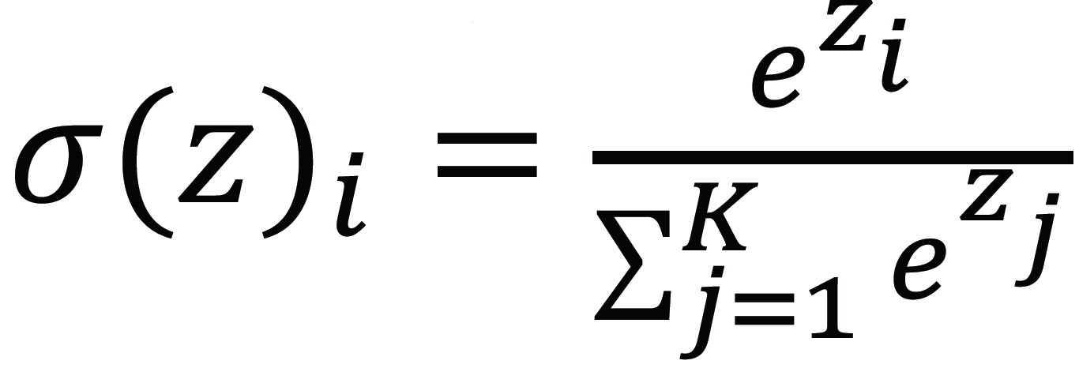
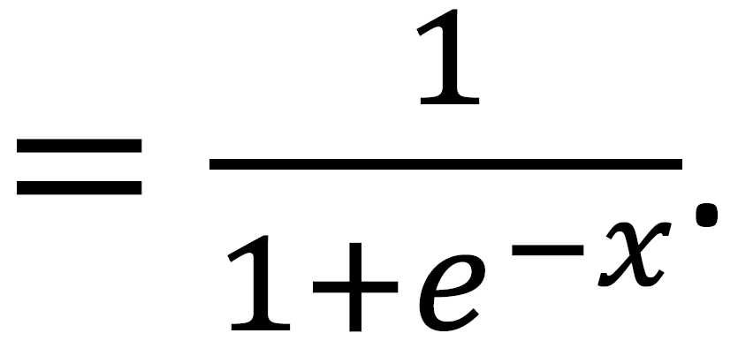

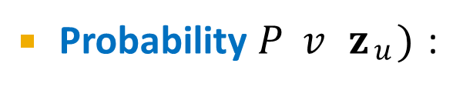
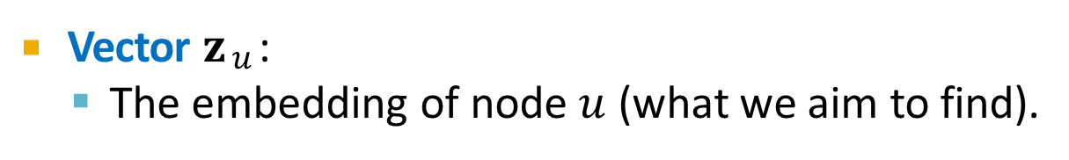
Vector 𝐳$u$:
The embedding of node 𝑢 (what we aim to find).
Probability 𝑃 𝑣 𝐳$u$) :
Our model prediction based on 𝐳$u$
The (predicted) probability of visiting node 𝑣 on random walks starting from node 𝑢.
Non-linear functions used to produce predicted probabilities
Softmax function
Turns vector of 𝐾 real values (model predictions) into
𝐾 probabilities that sum to 1:
.
Sigmoid function:
S-shaped function that turns real values into the range of (0, 1).
Written as 𝑆 𝑥

Slide 21



10
9
12
2
Step 3
Step 4
8
Step 5
1
3
11
Given a graph and a starting point, we select a neighbor of it at random, and move to this neighbor; then we select a neighbor of this point at random, and move to it, etc.
The (random) sequence of points visited this way is a random walk on the graph.
4
Step 1
Step 2
6
5
7

Slide 22
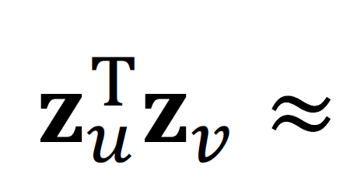
probability that u and v co-occur on a random walk over the graph

Slide 23
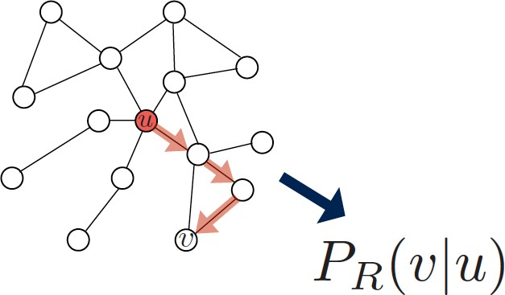
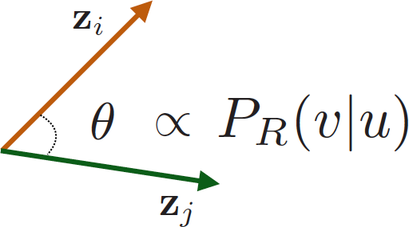
1. Estimate probability of visiting node 𝒗 on a random walk starting from node 𝒖 using some random walk strategy 𝑹
2. Optimize embeddings to encode these random walk statistics:
Similarity in embedding space (Here: dot product=cos(𝜃)) encodes random walk “similarity”

Slide 24

Expressivity: Flexible stochastic definition of node similarity that incorporates both local and higher-order neighborhood information Idea: if random walk starting from node 𝒖 visits 𝒗 with high probability, 𝒖 and 𝒗 are similar (high-order multi-hop information)
Efficiency: Do not need to consider all node pairs when training; only need to consider pairs that co-occur on random walks

Slide 25
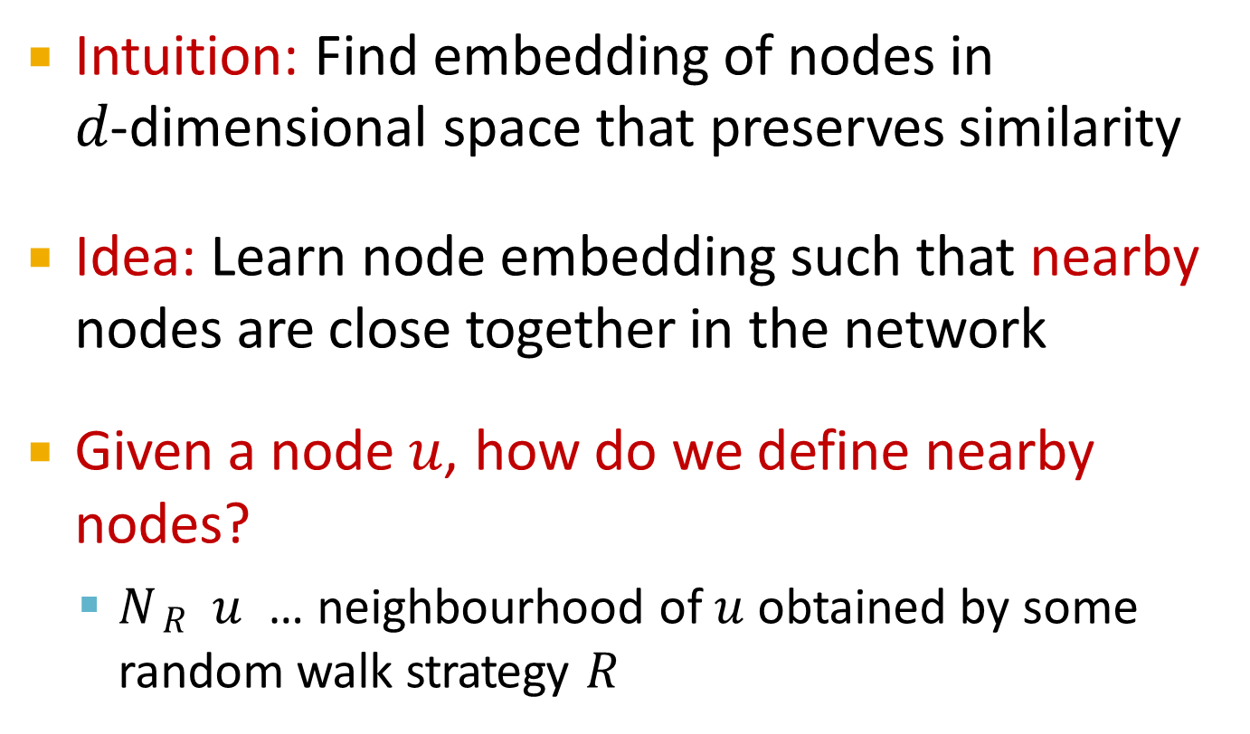
Intuition: Find embedding of nodes in
𝑑-dimensional space that preserves similarity
Idea: Learn node embedding such that nearby nodes are close together in the network
Given a node 𝑢, how do we define nearby nodes?
𝑁$R$ 𝑢 … neighbourhood of 𝑢 obtained by some random walk strategy 𝑅

Slide 26
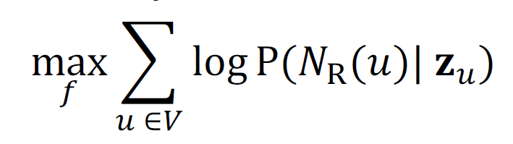
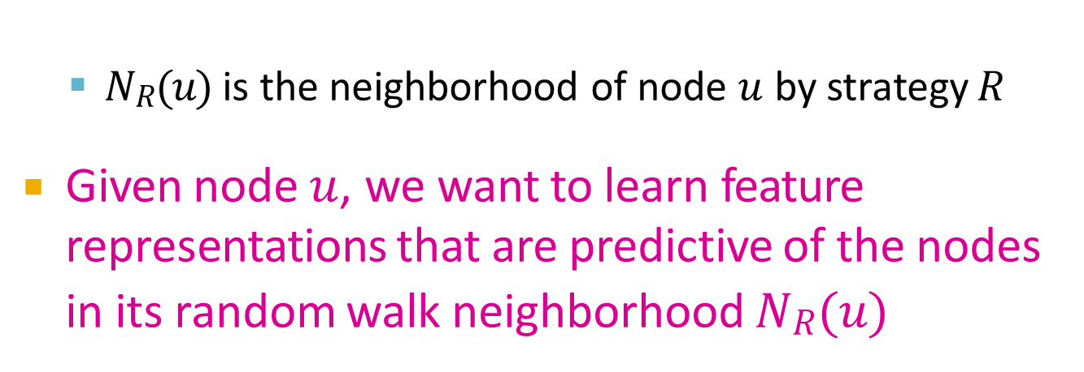
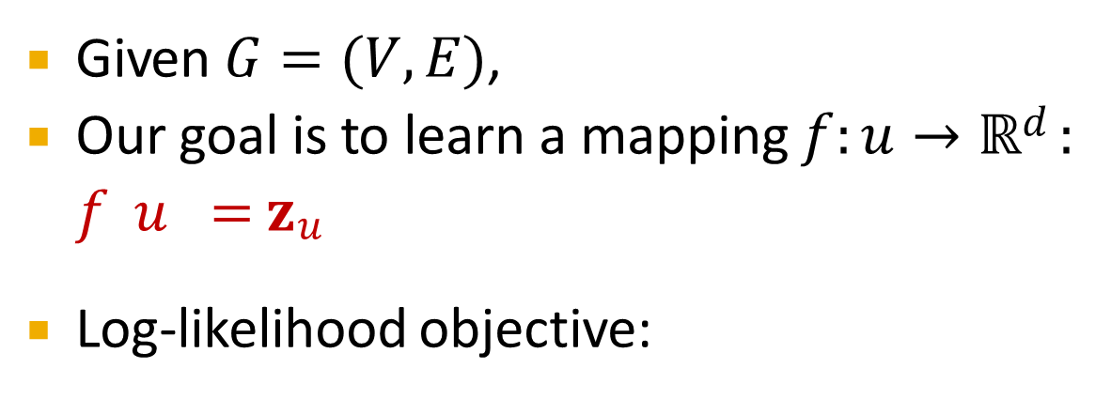
Given 𝐺 = (𝑉, 𝐸),
Our goal is to learn a mapping 𝑓: 𝑢 → ℝ$d$:
𝑓 𝑢 = 𝐳 $u$
Log-likelihood objective:
𝑁$R$(𝑢) is the neighborhood of node 𝑢 by strategy 𝑅
Given node 𝑢, we want to learn feature representations that are predictive of the nodes in its random walk neighborhood 𝑁$R$(𝑢)

Slide 27
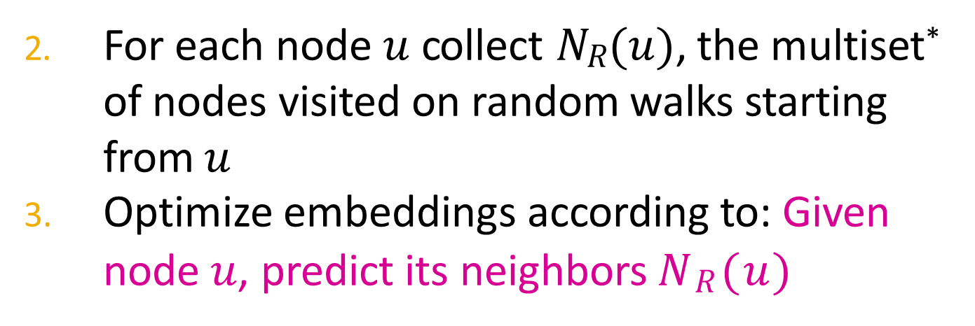
1. Run short fixed-length random walks starting from each node 𝑢 in the graph using some random walk strategy R
For each node 𝑢 collect 𝑁$R$(𝑢), the multiset* of nodes visited on random walks starting from 𝑢
Optimize embeddings according to: Given node 𝑢, predict its neighbors 𝑁$R$(𝑢)
Maximum likelihood objective
*𝑁$R$(𝑢) can have repeat elements since nodes can be visited multiple times on random walks

Slide 28
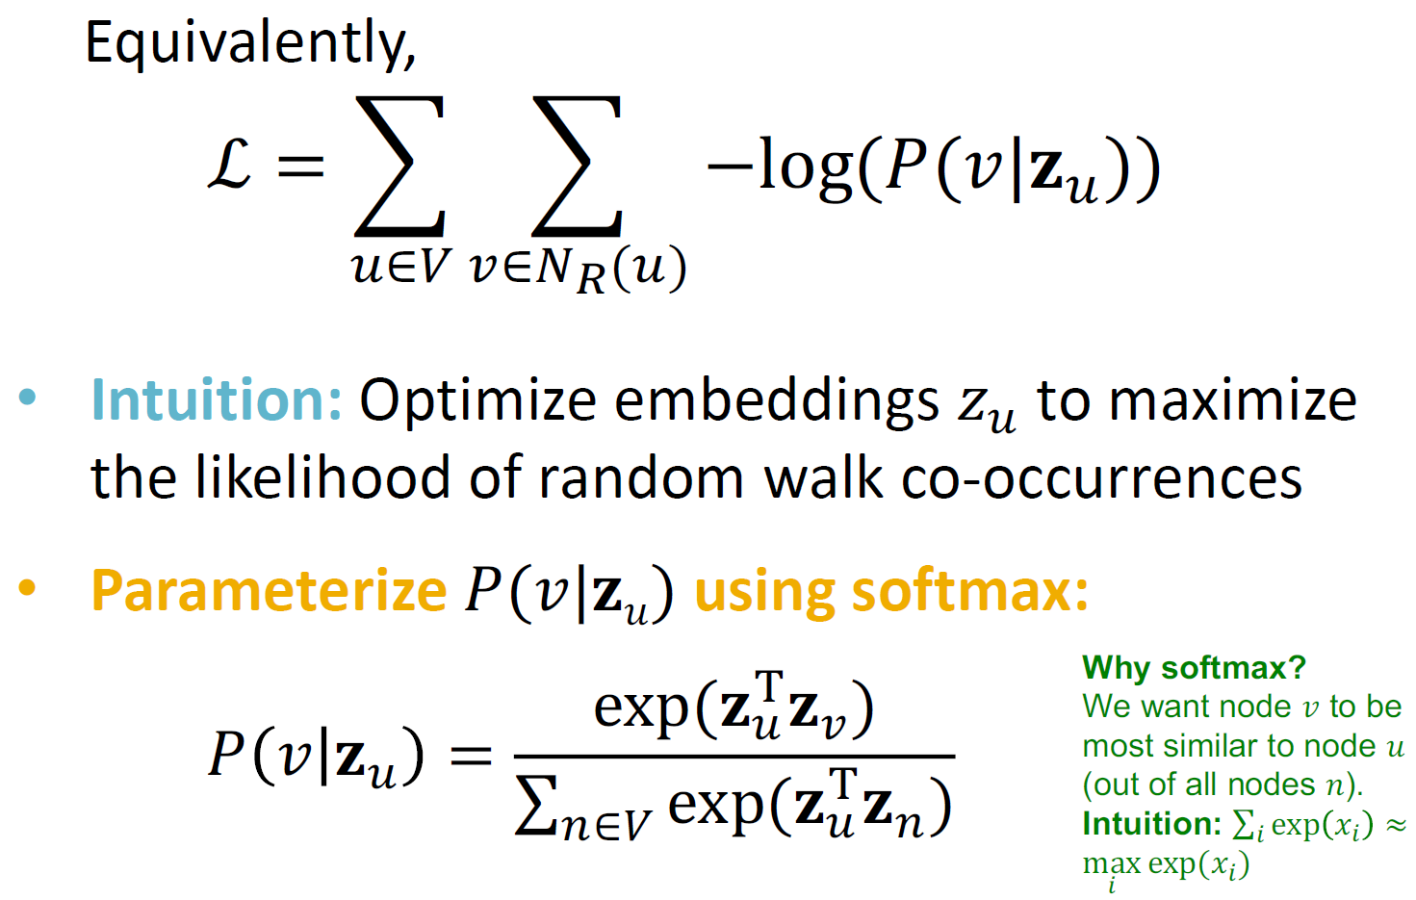

Slide 29
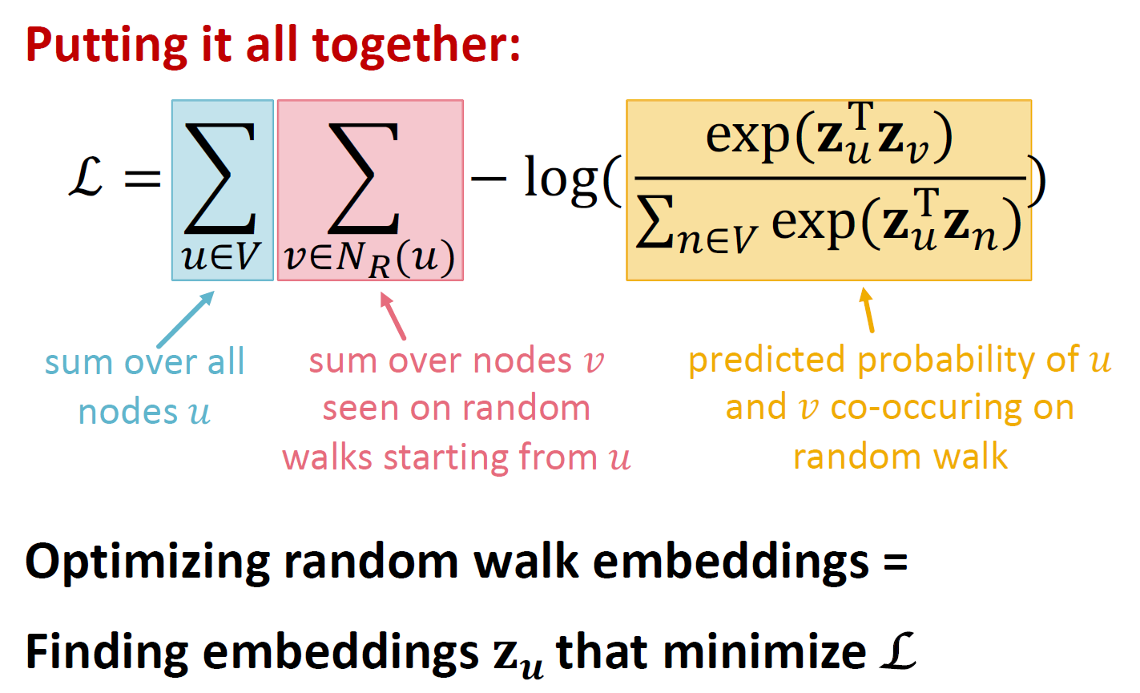

Slide 30
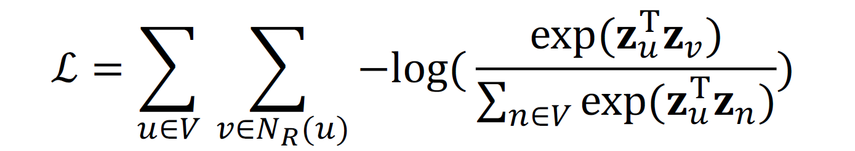
But doing this naively is too expensive!
Nested sum over nodes gives
O(|V|²) complexity!

Slide 31
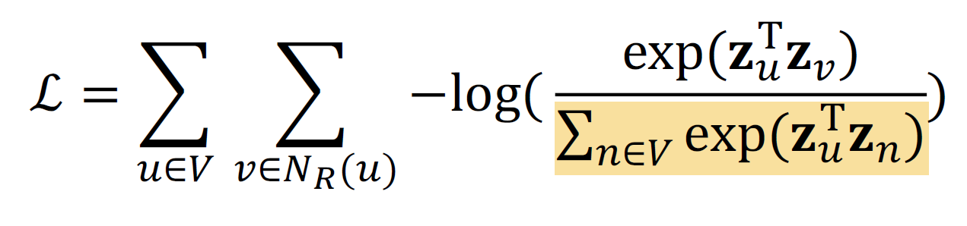
But doing this naively is too expensive!
The normalization term from the softmax is the culprit… can we approximate it?

Slide 32

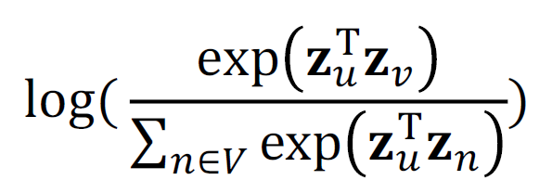
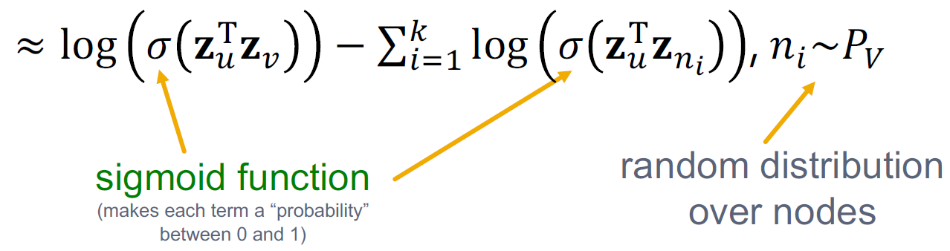
Why is the approximation valid? Technically, this is a different objective. But Negative Sampling is a form of Noise Contrastive Estimation (NCE) which approx. maximizes the log probability of softmax.
New formulation corresponds to using a logistic regression (sigmoid func.) to distinguish the target node 𝑣 from nodes 𝑛! sampled from background distribution 𝑃".
More at https://arxiv.org/pdf/1402.3722.pdf
Solution: Negative sampling
Instead of normalizing w.r.t. all nodes, just normalize against 𝑘 random “negative samples” 𝑛.

Slide 33
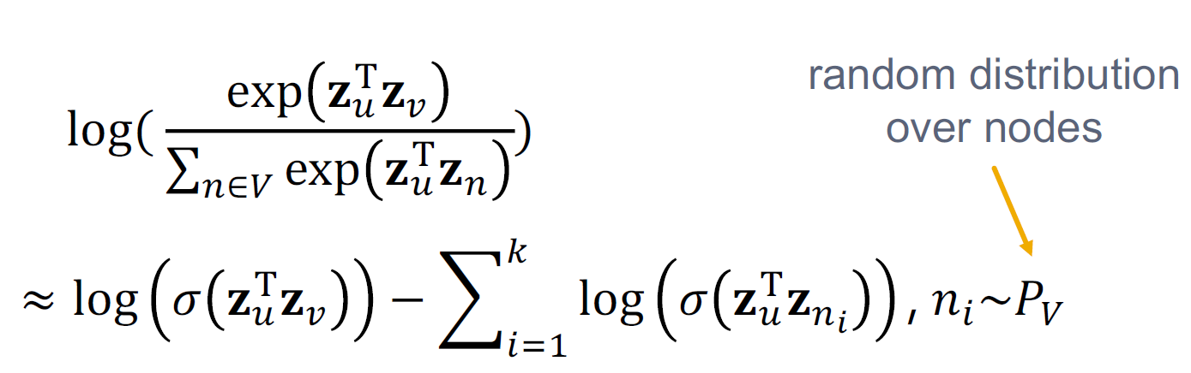
Sample 𝑘 negative nodes each with prob. proportional to its degree
Two considerations for 𝑘 (# negative samples):
Higher 𝑘 gives more robust estimates
Higher 𝑘 corresponds to higher bias on negative events In practice 𝑘 =5-20

Slide 34
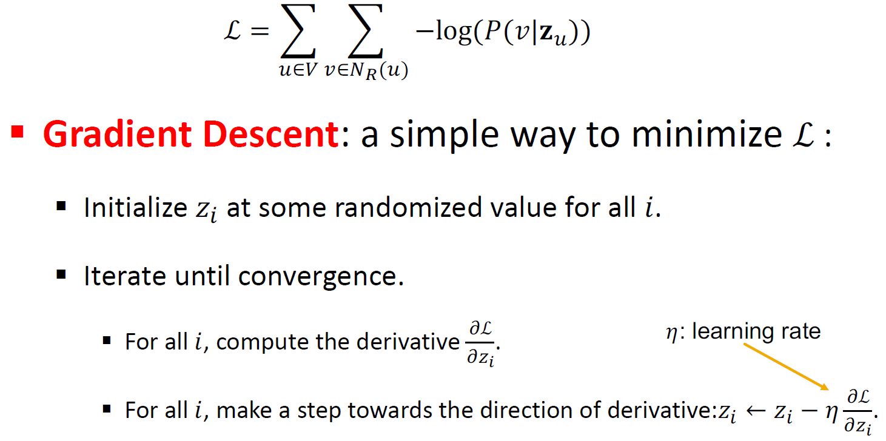
After we obtained the objective function, how do we optimize (minimize) it?

Slide 35
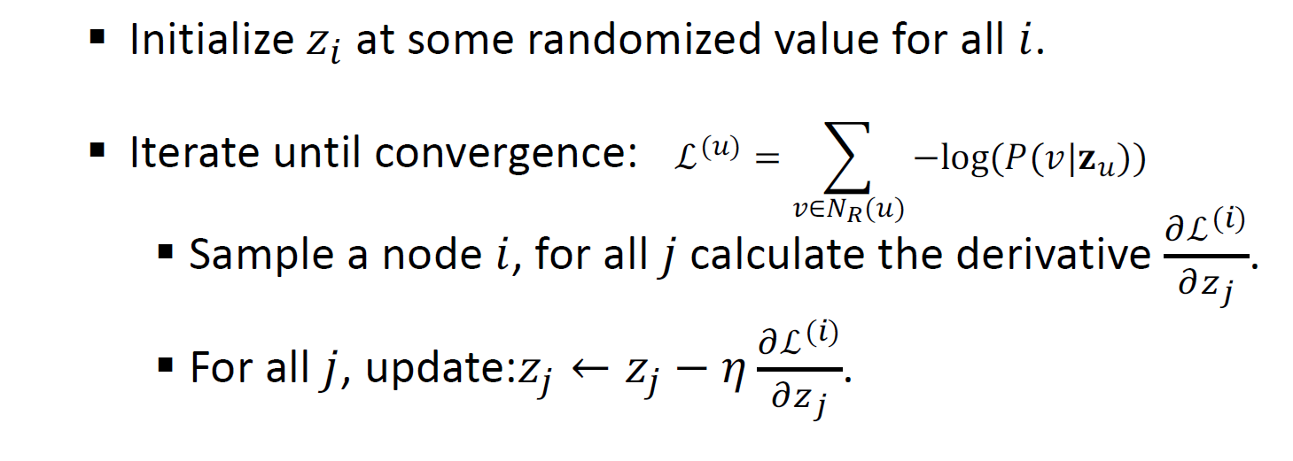
Stochastic Gradient Descent: Instead of evaluating gradients over all examples, evaluate it for each individual training example.

Slide 36
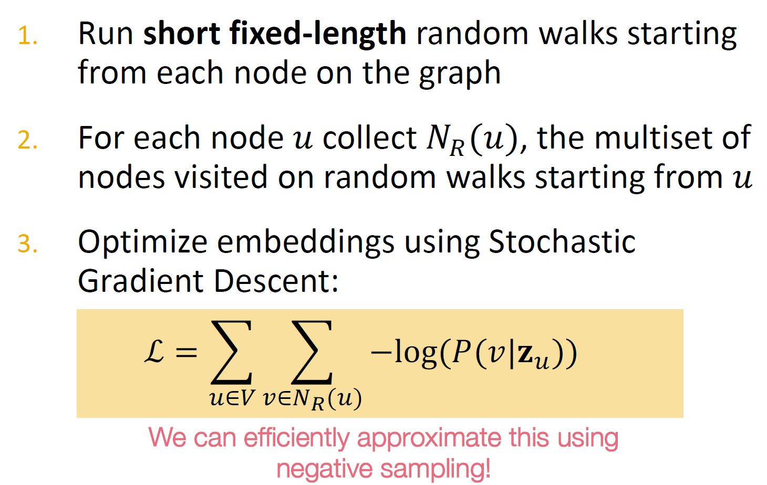

Slide 37
So far we have described how to optimize embeddings given a random walk strategy R
What strategies should we use to run these random walks?
Simplest idea: Just run fixed-length, unbiased random walks starting from each node (i.e., DeepWalk from Perozzi et al., 2013)
The issue is that such notion of similarity is too constrained
How can we generalize this?
Reference: Perozzi et al. 2014. DeepWalk: Online Learning of Social Representations. KDD.

Slide 38
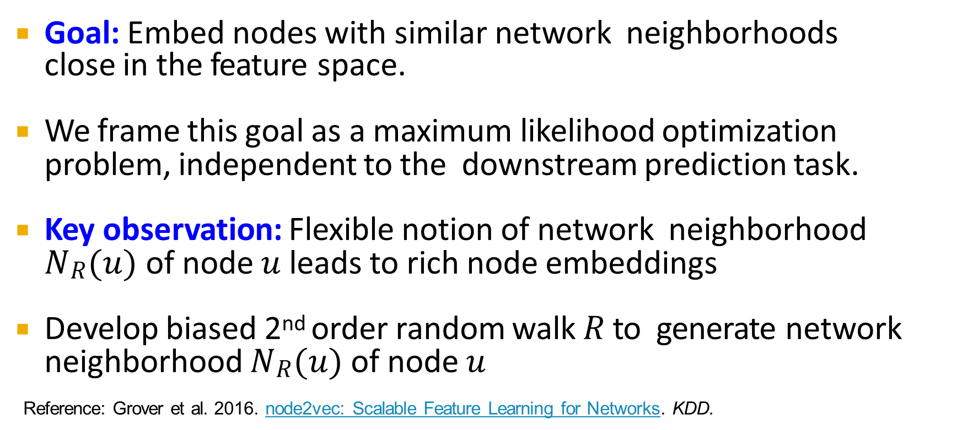
Goal: Embed nodes with similar network neighborhoods close in the feature space.
We frame this goal as a maximum likelihood optimization problem, independent to the downstream prediction task.
Key observation: Flexible notion of network neighborhood 𝑁$R$(𝑢) of node 𝑢 leads to rich node embeddings
Develop biased 2nd order random walk 𝑅 to generate network neighborhood 𝑁$R$(𝑢) of node 𝑢
Reference: Grover et al. 2016. node2vec: Scalable Feature Learning for Networks. KDD.

Slide 39

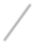



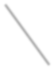
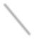


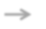

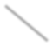
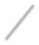
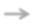









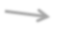

Idea: use flexible, biased random walks that can trade off between local and global views of the network (Grover and Leskovec, 2016).
s₁
s₂
s₈
s
BFS DFS
7
u
s₆
s₄
s₉
s
s₅
3

Slide 40








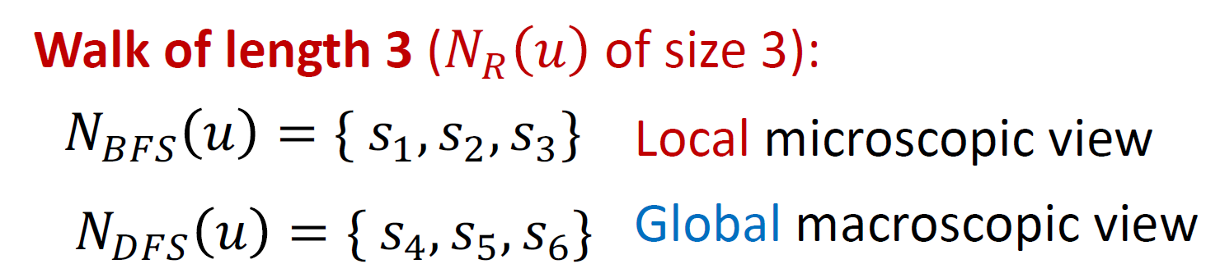
Two classic strategies to define a neighborhood 𝑵_{𝑹} 𝒖 of a given node 𝒖:
s₁
s₂
s₈
s
BFS DFS
7
u
s₆
s₄
s₉
s
s₅
3

Slide 41

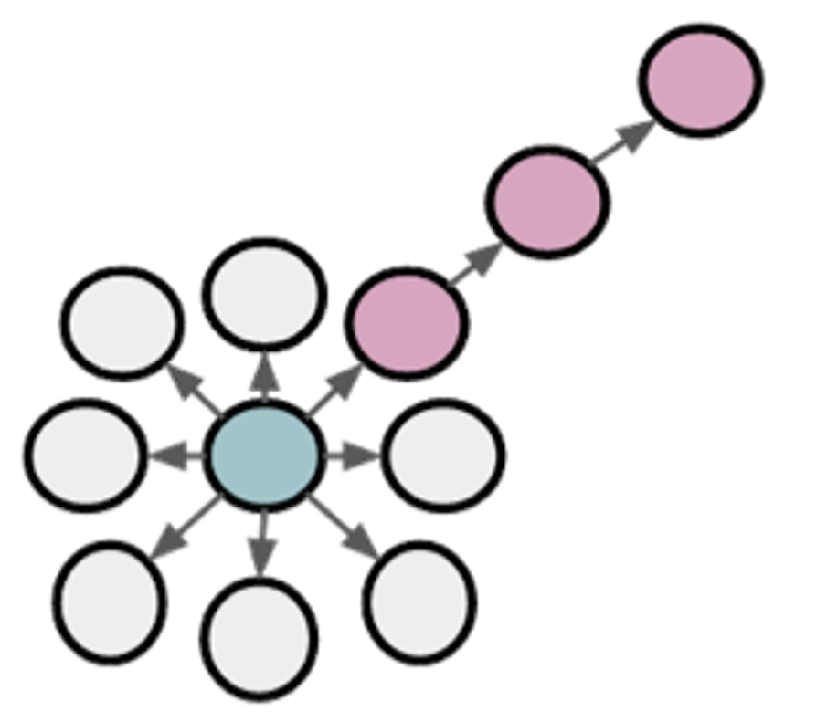


u
BFS:
Micro-view of neighbourhood
DFS:
Macro-view of neighbourhood

Slide 42
Biased fixed-length random walk 𝑹 that given a node 𝒖 generates neighborhood 𝑵_{𝑹} 𝒖
Two parameters:
Return parameter 𝒑:
Return back to the previous node
In-out parameter 𝒒:
Moving outwards (DFS) vs. inwards (BFS)
Intuitively, 𝑞 is the “ratio” of BFS vs. DFS

Slide 43
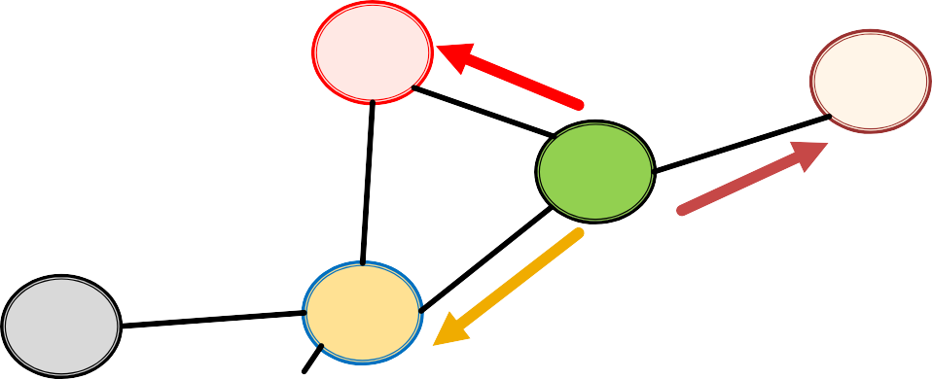
Biased 2nd-order random walks explore network neighborhoods:
Random walk just traversed edge (𝑠₁, 𝑤) and is now at 𝑤
Insight: Neighbors of 𝑤 can only be:
Same distance to 𝒔_{𝟏}
s₂
s₃
Farther from 𝒔_{𝟏}
w
u
s₁
Back to 𝒔_{𝟏}
Idea: Remember where the walk came from

Slide 44
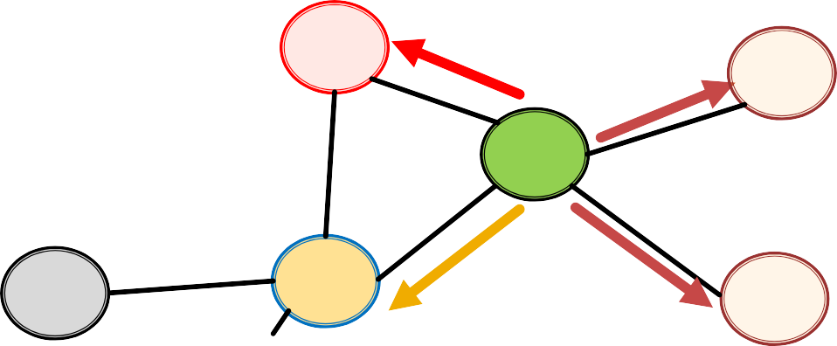
Walker came over edge (𝐬_{𝟏}, 𝐰) and is at 𝐰. Where to go next?
s₂
1
1/𝑞
s
1/𝑝, 1/𝑞, 1 are unnormalized probabilities
3
w
1/𝑞
u
s₁
1/𝑝
s
4
𝑝, 𝑞 model transition probabilities
𝑝 … return parameter
𝑞 … ”walk away” parameter

Slide 45
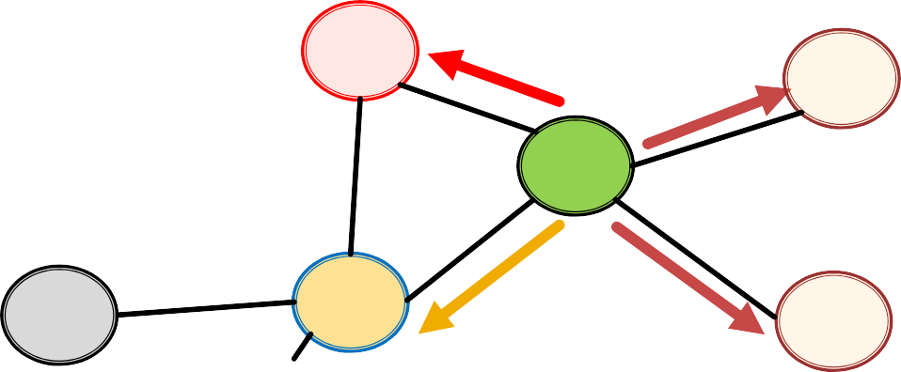

Walker came over edge (𝐬_{𝟏}, 𝐰) and is at 𝐰. Where to go next?
Target 𝒕 Prob. Dist. (𝒔_{𝟏}, 𝒕)
0
1
2
2
s₂
1
1/𝑞 s
s₁ s₂ s₃ s₄
1/𝑝
1
1/𝑞
1/𝑞
3
w
w →
1/𝑞
u
s₁
1/𝑝
s
4
BFS-like walk: Low value of 𝑝
DFS-like walk: Low value of 𝑞
Unnormalized transition prob. segmented based on distance from 𝑠₁
𝑁$R$ (𝑢) are the nodes visited by the biased walk

Slide 46

1) Compute random walk probabilities
2) Simulate 𝑟 random walks of length 𝑙 starting from each node 𝑢
3) Optimize the node2vec objective using
Stochastic Gradient Descent
Linear-time complexity
All 3 steps are individually parallelizable

Slide 47
Different kinds of biased random walks:
Based on node attributes (Dong et al., 2017).
Based on learned weights (Abu-El-Haija et al., 2017)
Alternative optimization schemes:
Directly optimize based on 1-hop and 2-hop random walk probabilities (as in LINE from Tang et al. 2015).
Network preprocessing techniques:
Run random walks on modified versions of the original network (e.g., Ribeiro et al. 2017’s struct2vec, Chen et al. 2016’s HARP).

Slide 48

Core idea: Embed nodes so that distances in embedding space reflect node similarities in the original network.
Different notions of node similarity:
Naïve: similar if 2 nodes are connected
Neighborhood overlap (covered in the former topic)
Random walk approaches (covered today)

Slide 49
So what method should I use..?
No one method wins in all cases….
E.g., node2vec performs better on node classification while alternative methods perform better on link prediction (Goyal and Ferrara, 2017 survey)
Random walk approaches are generally more efficient
In general: Must choose definition of node similarity that matches your application!

Slide 50
Embedding Entire Graphs

Slide 51
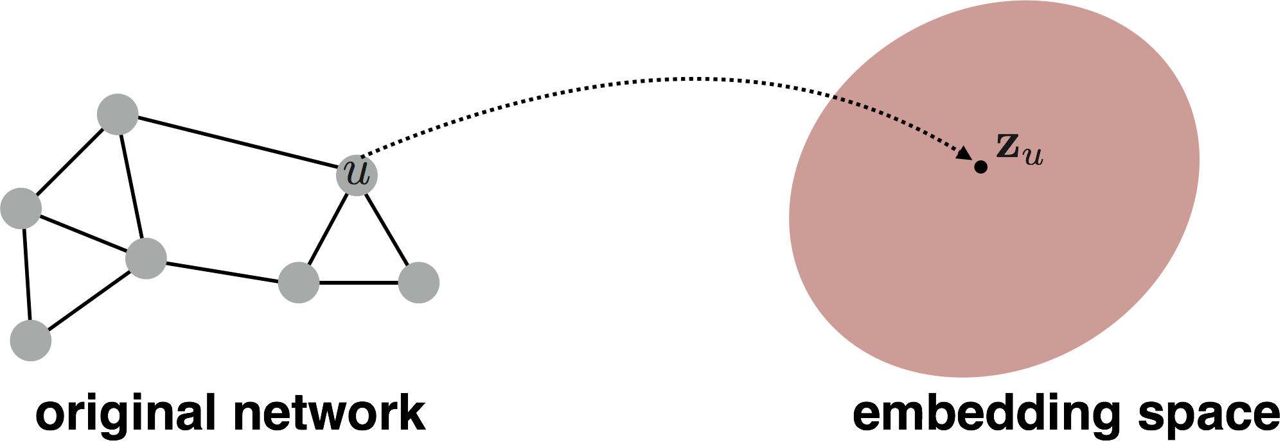
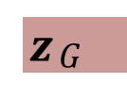
Goal: Want to embed a subgraph or an entire graph 𝐺. Graph embedding: 𝐳_{𝑮}.
𝒛$G$
Tasks:
Classifying toxic vs. non-toxic molecules
Identifying anomalous graphs

Slide 52


Simple idea 1:
Run a standard graph embedding technique on the (sub)graph 𝐺
Then just sum (or average) the node embeddings in the (sub)graph 𝐺
Used by Duvenaud et al., 2016 to classify molecules based on their graph structure

Slide 53


Idea 2: Introduce a “virtual node” to represent the (sub)graph and run a standard graph embedding technique
Proposed by Li et al., 2016 as a general technique for subgraph embedding

Slide 54

States in anonymous walks correspond to the index of the first time we visited the node in a random walk
Anonymous Walk Embeddings, ICML 2018 https://arxiv.org/pdf/1805.11921.pdf

Slide 55


Agnostic to the identity of the nodes visited (hence anonymous)
Example RW1:
Step 1: node A
Step 2: node B
Step 3: node C
Step 4: node B
Step 5: node C
node 1
node 2 (different from node 1)
node 3 (different from node 1, 2) node 2 (same as the node in step 2) node 3 (same as the node in step 3)
Note: RW2 gives the same anonymous walk

Slide 56


Number of anonymous walks grows exponentially:
There are 5 anon. walks 𝑤$i$ of length 3:
𝑤₁=111, 𝑤₂=112, 𝑤₃= 121, 𝑤₄= 122, 𝑤₅= 123

Slide 57

Simulate anonymous walks 𝑤. of 𝑙 steps and record their counts
Represent the graph as a probability
distribution over these walks
For example:
Set 𝑙 = 3
Then we can represent the graph as a 5-dim vector
Since there are 5 anonymous walks 𝑤$i$of length 3: 111, 112, 121, 122, 123
𝒁_{𝑮}[𝑖] = probability of anonymous walk 𝑤$i$ in 𝐺

Slide 58

Sampling anonymous walks: Generate independently a set of 𝑚 random walks
Represent the graph as a probability distribution over these walks
How many random walks 𝑚 do we need?
We want the distribution to have error of more than
𝜀 with prob. less than 𝛿:
For example:
There are 𝜂 = 877
anonymous walks of length
𝑙 = 7. If we set
𝜀 = 0.1 and 𝛿 = 0.01 then we need to generate
𝑚=122,500 random walks
𝑚 = ² (log 2$η$ − 2 − log 𝛿 )
_{𝜀}2
where: 𝜂 is the total number of anon. walks of length 𝑙.

Slide 59

Rather than simply represent each walk by the fraction of times it occurs, we learn embedding
𝒛_{𝒊} of anonymous walk 𝒘_{𝒊}
Learn a graph embedding 𝒁_{𝑮} together with all the anonymous walk embeddings 𝒛_{𝒊}
𝑍 = {𝑧$i$: 𝑖 = 1 … 𝜂}, where 𝜂 is the number of
sampled anonymous walks.
How to embed walks?
Idea: Embed walks s.t. the next walk can be predicted

Slide 60


Slide 61


Anonymous Walk Embeddings, ICML 2018 https://arxiv.org/pdf/1805.11921.pdf

Slide 62

We obtain the graph embedding 𝒛_{𝑮} (learnable parameter) after optimization
Use 𝒛_{𝑮}to make predictions (e.g. graph classification)
Option1: Inner product
Overall Architecture
Kernel 𝒛^{T} 𝒛_{𝑮}
𝑮_{𝟏}
𝟐
Option2: Use a neural network that takes 𝒛_{𝑮} as input to classify

Slide 63

We discussed 3 ideas to graph embeddings
Approach 1: Embed nodes and sum/avg them
Approach 2: Create super-node that spans the (sub) graph and then embed that node
Approach 3: Anonymous Walk Embeddings
Idea 1: Sample the anon. walks and represent the graph as fraction of times each anon walk occurs
Idea 2: Embed anonymous walks, concatenate their embeddings to get a graph embedding

Slide 64

There are more advanced ways to obtain graph embeddings.
We can hierarchically cluster nodes in graphs, and sum/avg the node embeddings according
to these clusters.

Slide 65


Slide 66
We discussed graph representation learning, a way to learn node and graph embeddings for downstream tasks, without feature engineering.
Learning Outcomes
Encoder-decoder framework:
Encoder: embedding lookup
Decoder: predict score based on embedding to match node similarity
Node similarity measure: (biased) random walk
Examples: DeepWalk, Node2Vec
Extension to Graph embedding: Node embedding aggregation and Anonymous Walk Embeddings
Acknowledgement: Jure Leskovec, Stanford University

